Slide 1
Hamster Capstone 33% Status Update
By: Jared Hemauer, Rylee Horney, Keenan Keams, Joseph Lopez

Slide 2
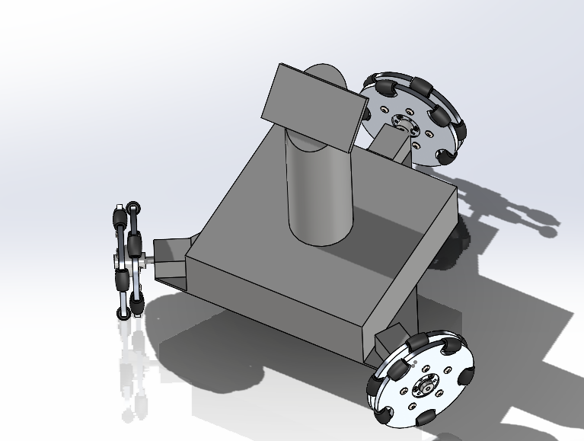
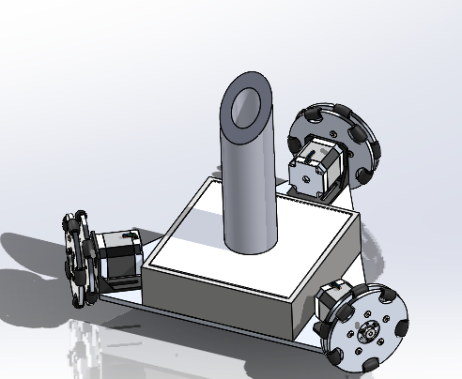
1st & 2nd Iteration of Hamster

Slide 3
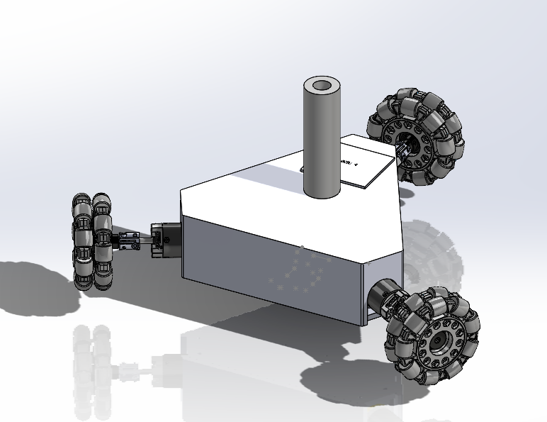
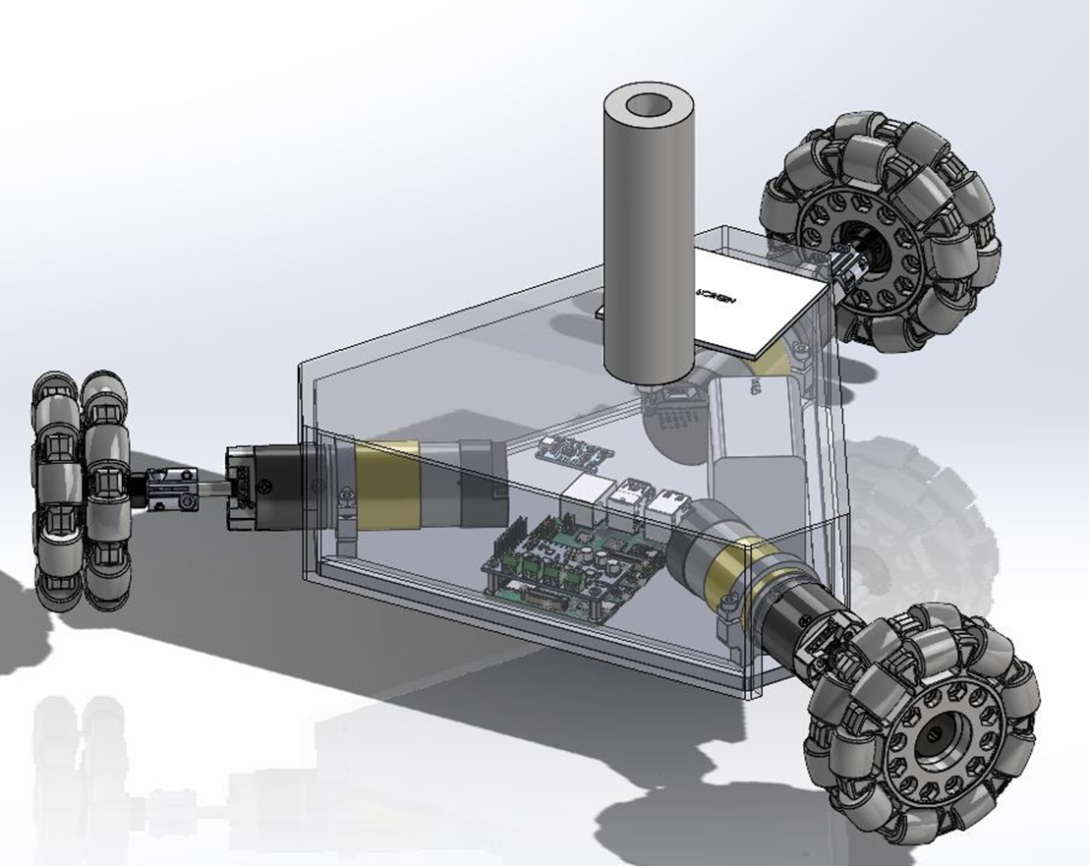
3rd Iteration of Hamster

Slide 4
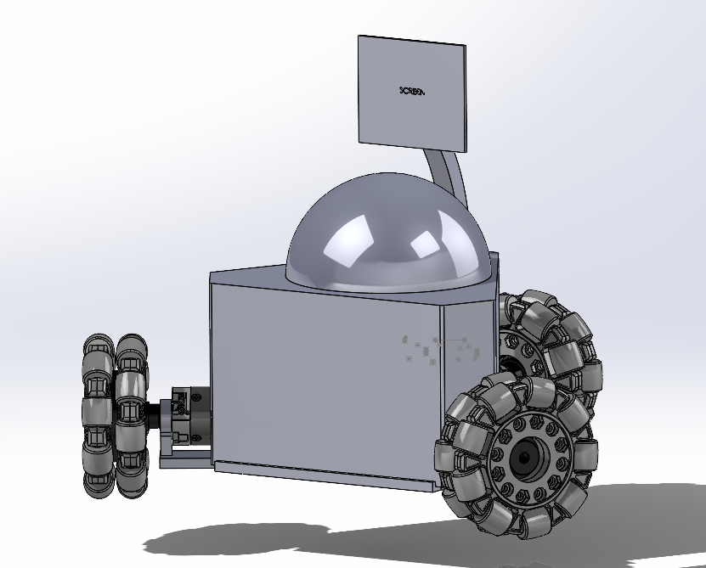
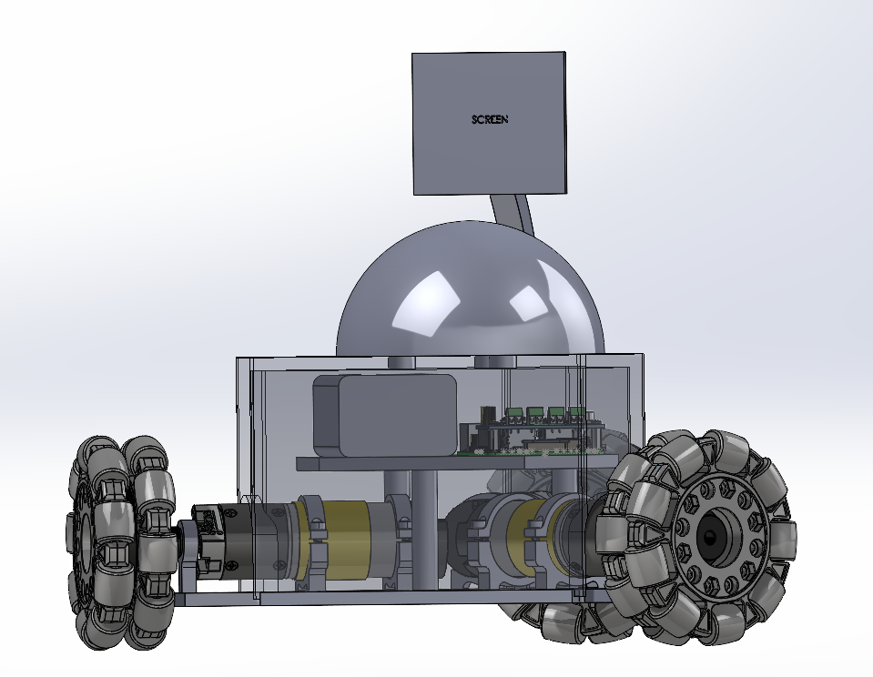
4th Iteration of Hamster

Slide 5
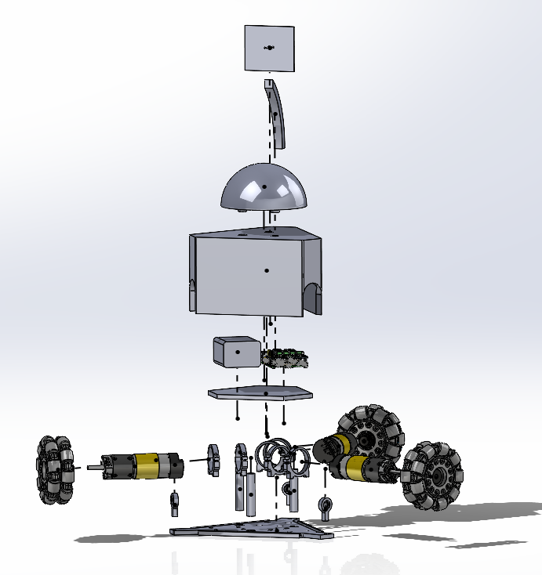
Exploded View

Slide 6
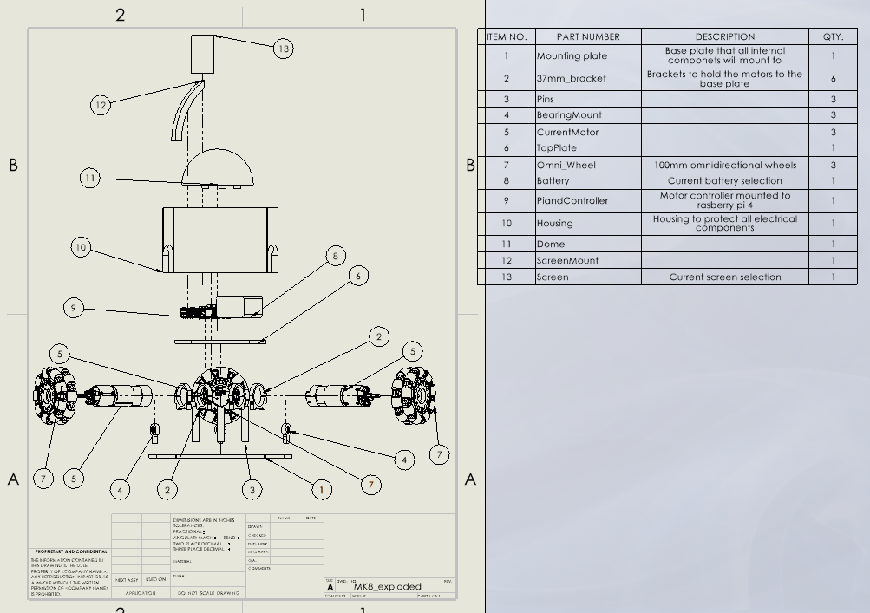
Exploded View Drawing

Slide 7
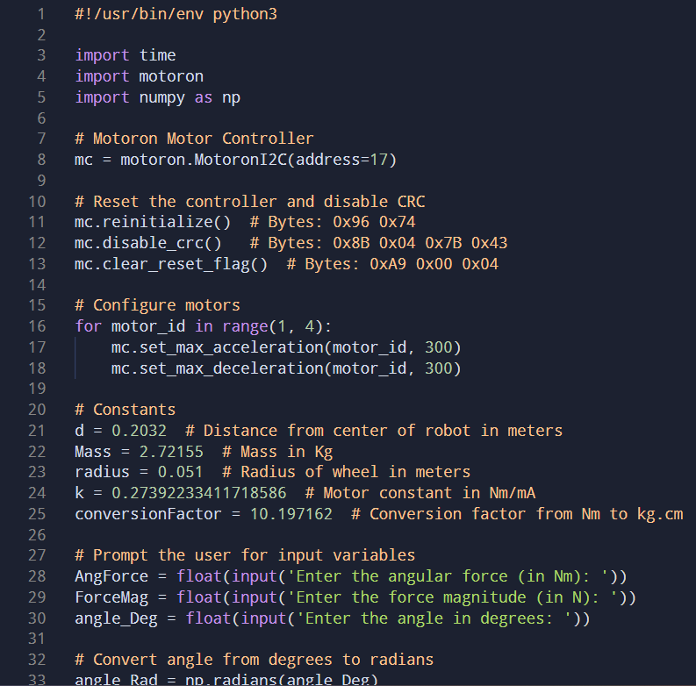
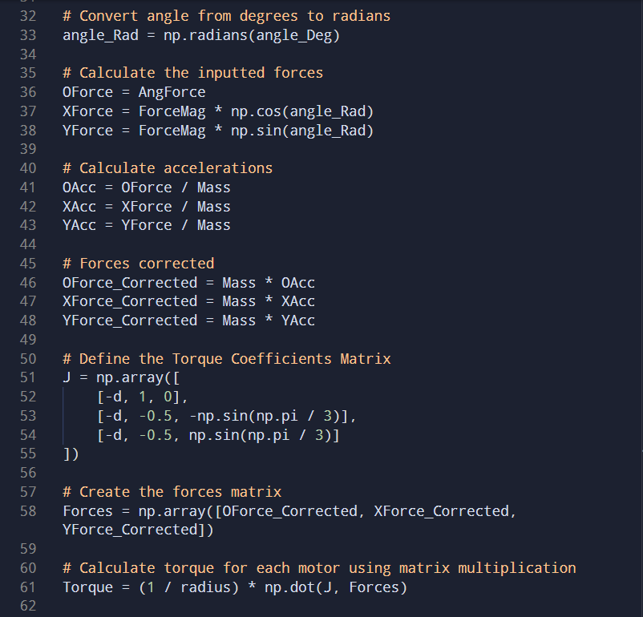
Coding for Robot

Slide 8
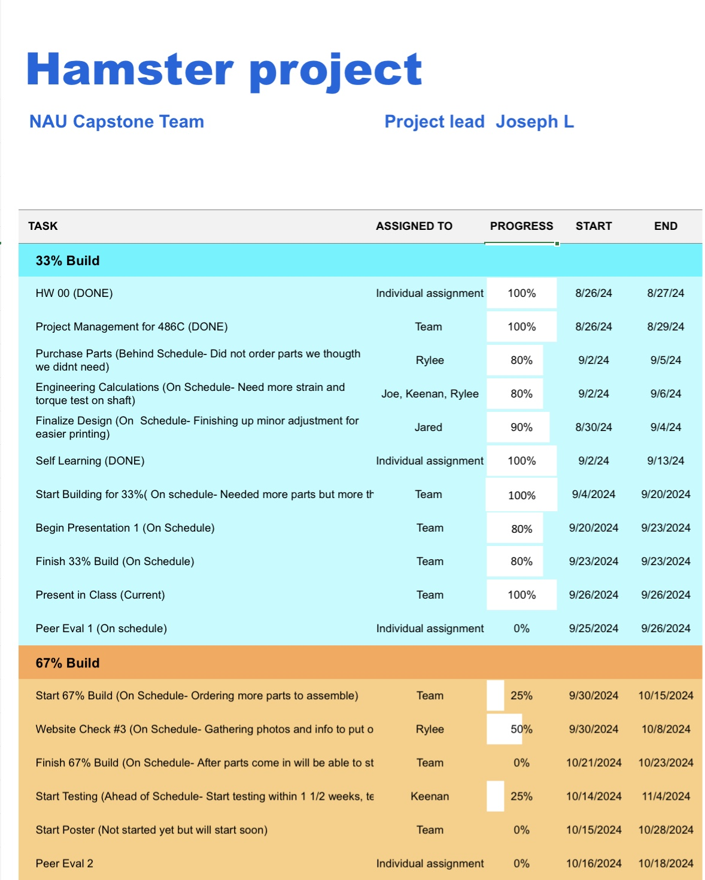
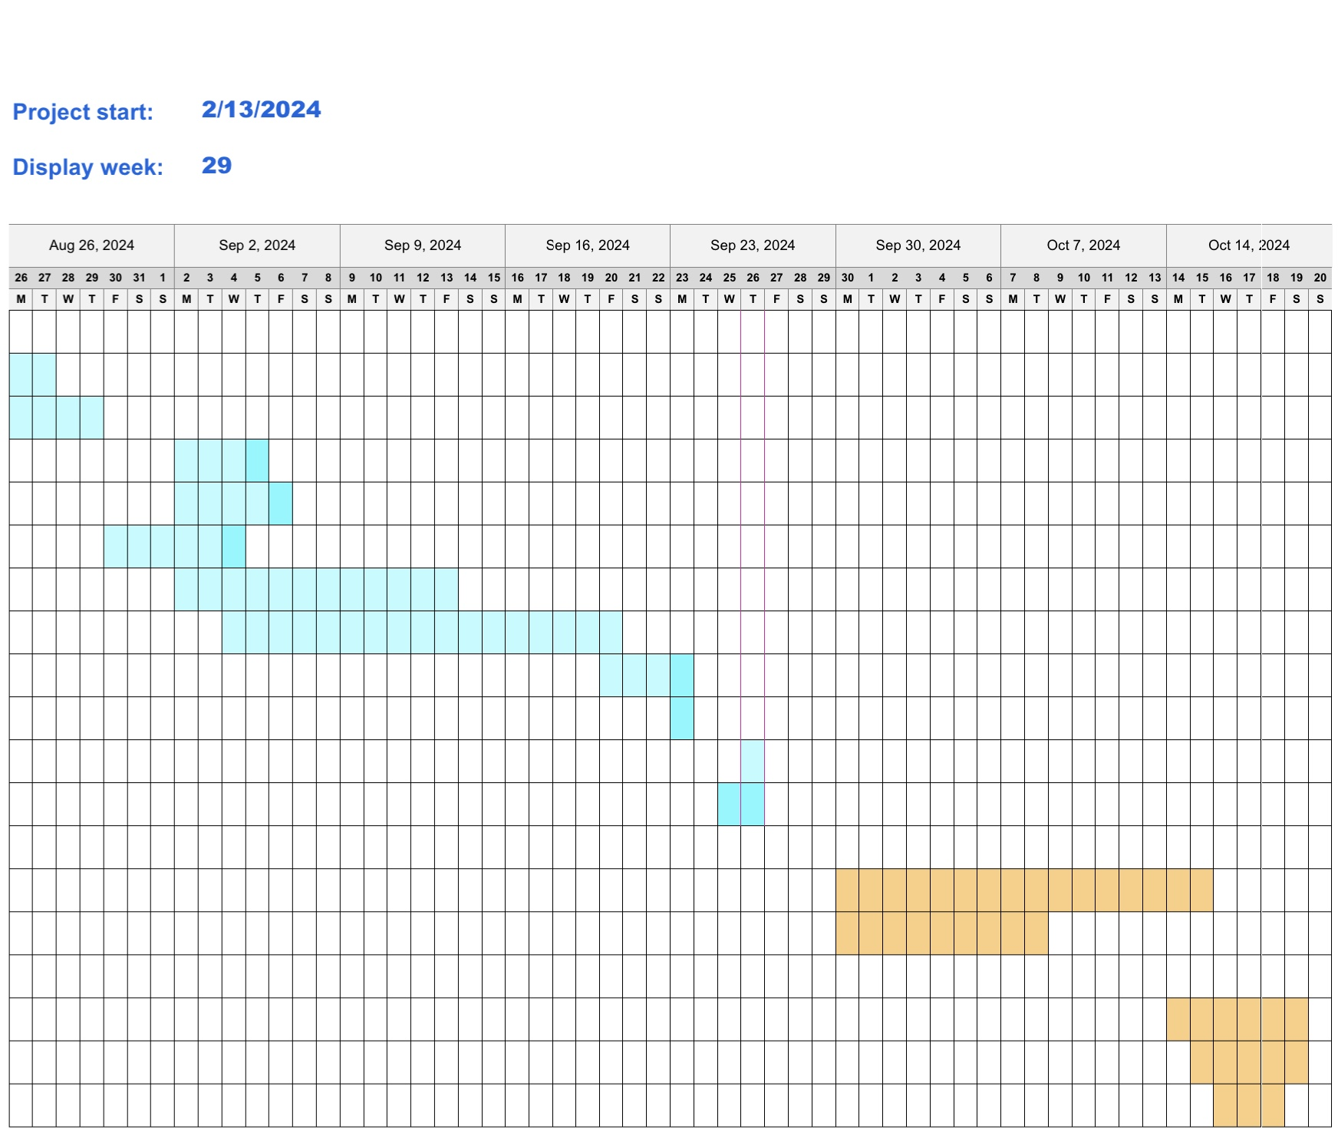
Gantt Chart Update

Slide 9
Thank you

